Slide 1
Vertical Variation of Selected Secondary Radio-Climatic Parameters
PRESENTED BY
OLASUPO MAYOWA EBENEZER
PHY/20/7261

Slide 2
OUTLINE
INTRODUCTION
OBJECTIVE
LITERATURE REVIEW
METHODOLOGY
RESULT AND DISCUSSION
CONCLUSION
RECOMMENDATION

Slide 3
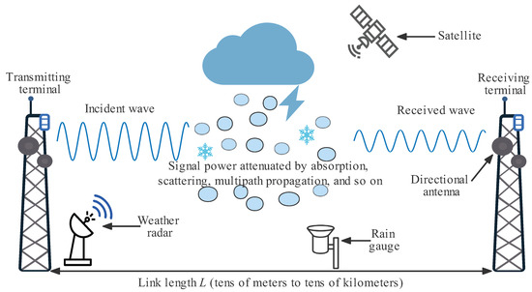
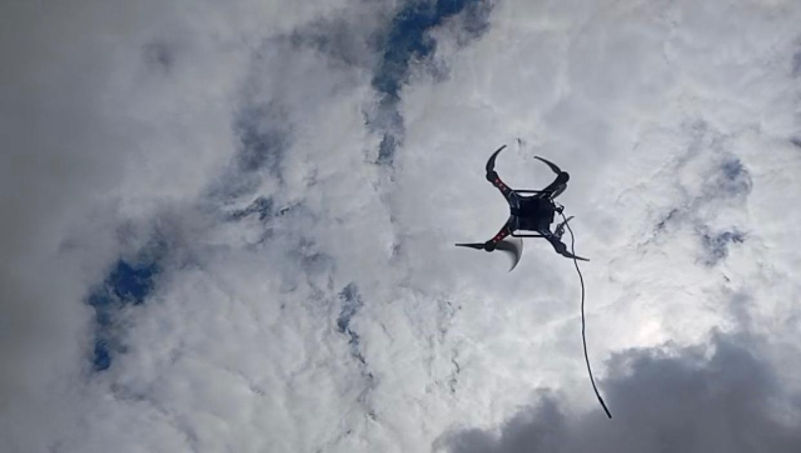
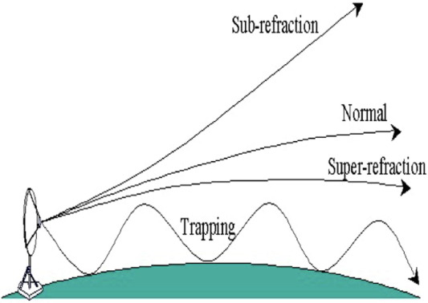
Introduction
This study Collected primary radio climatic datas using integrated UAVs to investigates the vertical variation of secondary radio-climatic parameters, such as radio refractivity, refractivity gradient, and geo-climatic factor and their impact on electromagnetic wave propagation.

Slide 4
Radio refractivity is a factor used in determining how radio waves propagate through the troposphere and lower atmosphere.
The refractivity gradient is a key factor in determining how radio waves bend in the atmosphere. It measures how fast refractivity (N) changes with height.
The geoclimatic factor is used in radio wave propagation studies,
for estimating Signal Fading and Multipath Propagation

Slide 5
Objectives of the Study
Examine vertical variations of secondary parameters.
Analyze synoptic hour variations.
Assess implications on communication systems.

Slide 6
LITERATURE REVIEW
Parameters | Author | Review
Radio refractivity | Falodun and Ajewole (2006) | Reported diurnal variations over Akure, Nigeria, with refractivity minima around mid-morning and maxima during late evening
Refractivity gradient | Fashade et al. (2023), ITU-R P.453-13. ( 2019) | Reported that refractivity decreases gradually with height, resulting in signals bending gently towards the Earth and extending the radio horizon
Geo-climatic factor | Adediji et al. (2011) | Reported that diurnal heating significantly modulates geo-climatic factors in tropical regions

Slide 7
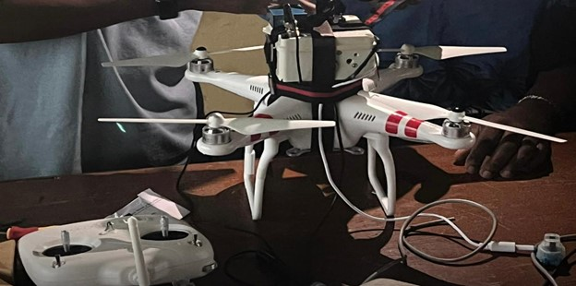
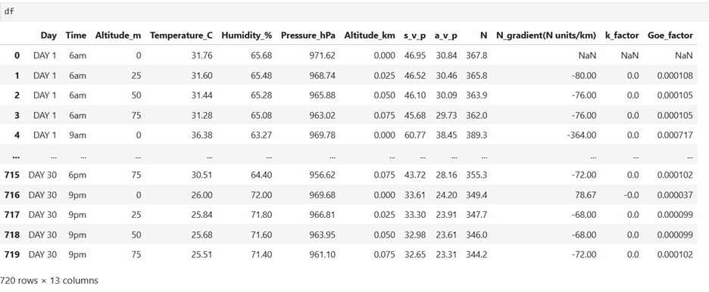
Methodology
UAVs with sensors (temperature, pressure, humidity).
Data was computed with python to derive secondaryradio-climatic parameters and analysis.
Time Series Analysis (6am, 9am, 12pm, 3pm, 6pm, 9pm).
Vertical Profile Analysis
Trend Analysis

Slide 8
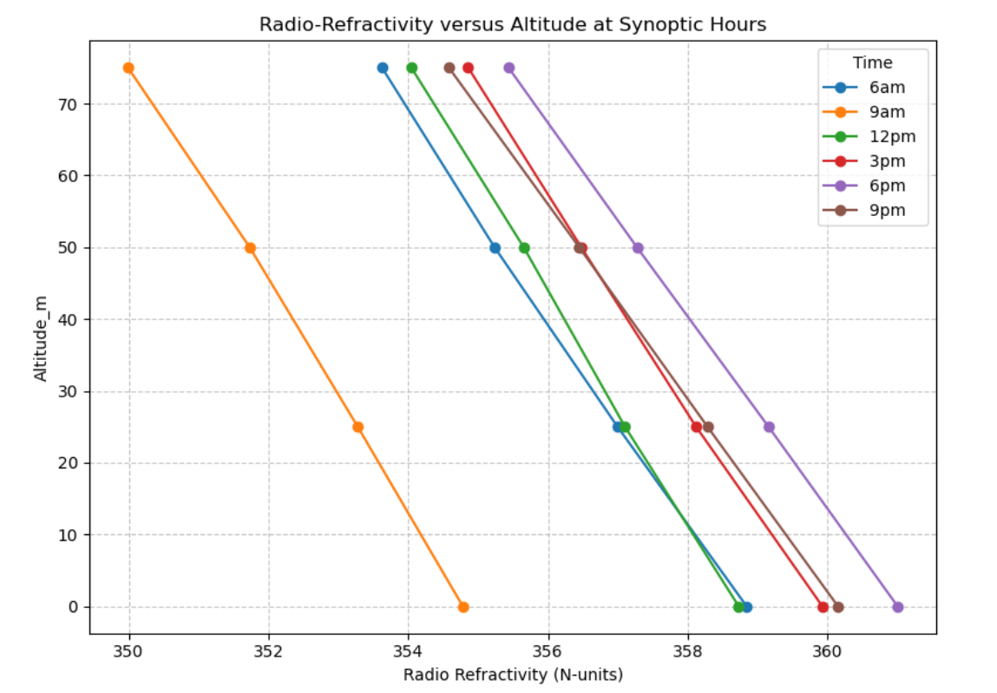
Vertical Variation of Radio-Refractivity (N)
-The lower troposphere, has highest refractivity values because it contains a higher concentration of water vapor
-Radio-refractivity reduces with height
This is the normal condition in the atmosphere which causes radio waves to bend slightly toward the Earth, extending range.
- 350 to 360 indicate super refraction which bends signal towards earth

Slide 9
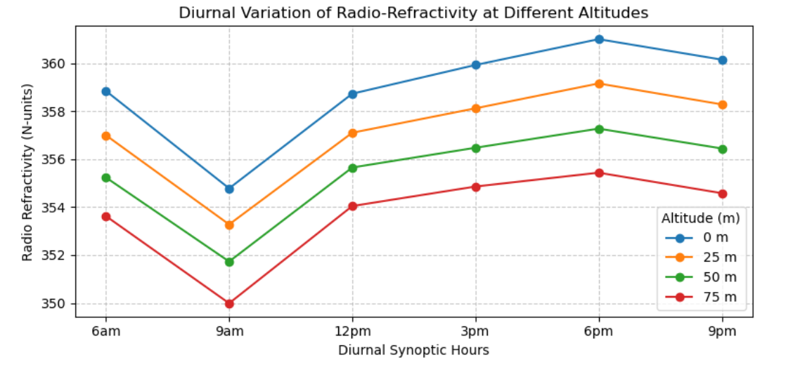
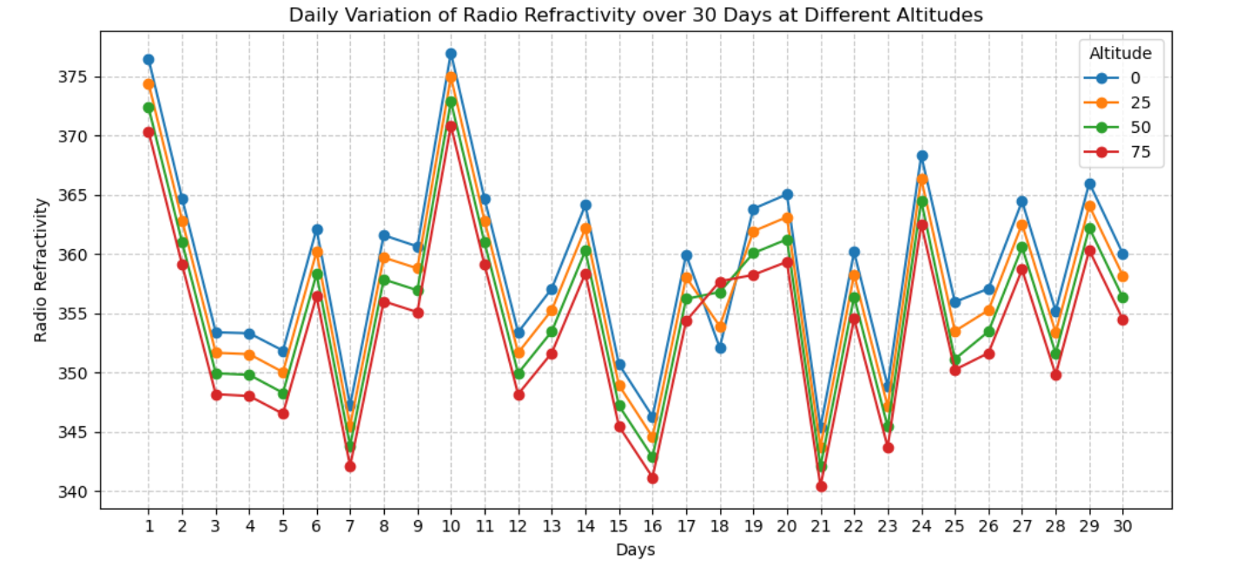
Diurnal and Daily Variation of Refractivity

Slide 10
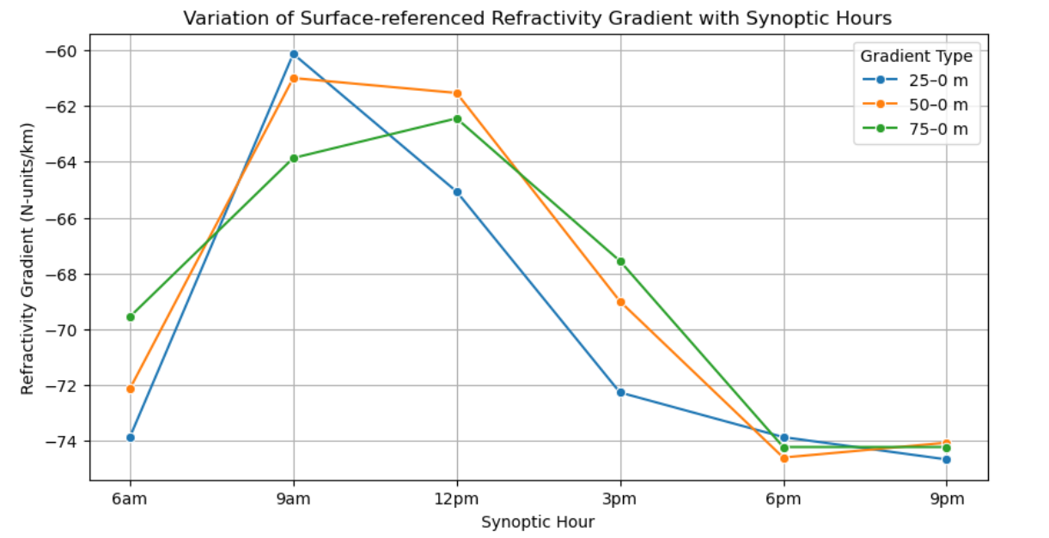
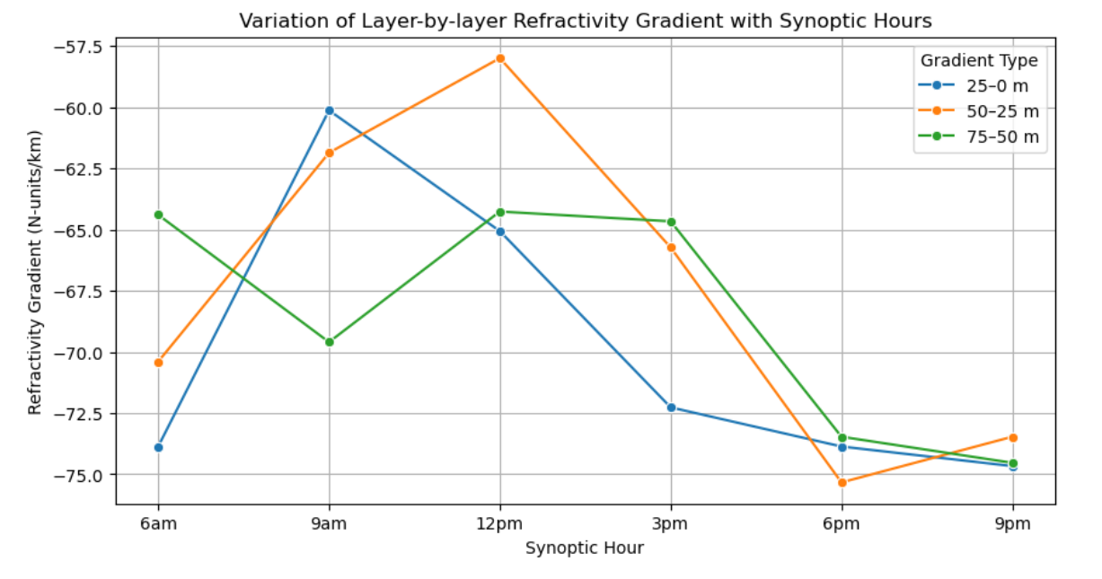
Refractivity Gradient (dN/dh)
- Gradient is ranges from -58 to - 76 indicate super refraction which makes waves to bends more and extend coverage
- Surface cooling & solar heating contribution

Slide 11
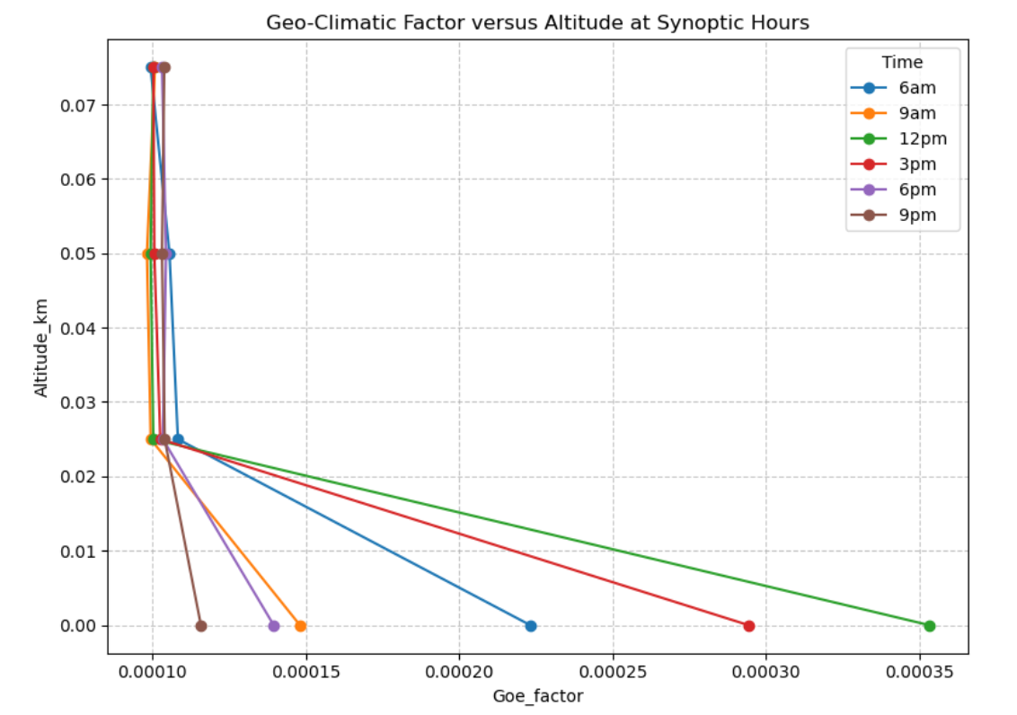
Geo-Climatic Factor (ΔN)
higher values concentrated near the surface (0–25 m) and tapering off beyond 50 m.
Geo-climatic factor ranges 0.00010 to – 0.00015 indicates moderate multipath fading. Occur during early and late hours
Geo-climatic factor ranges 0.00020 to – 0.00037 indicates severe multipath fading. Occur during midday
Crucial for spectrum allocation & reliability studies

Slide 12
Conclusion
As Refractivity explains general propagation,
Gradient: explains abnormal propagation. And ΔN: indicates long-term reliability.
This proves that secondary radio-climatic parameters strongly affect EM propagation.
UAV profiling captures fine-scale vertical variations to improve accuracy of refractivity modeling.

Slide 13
Recommendations
Vertical profiling essential; only surface and stationed data is insufficient
Future studies should extend measurements beyond 75 m, ideally up to several hundred meters, to fully capture the vertical distribution
Extend study to seasonal variation for more accurate analysis.

Slide 14
THANK YOU
FOR LISTENING

